Slide 1
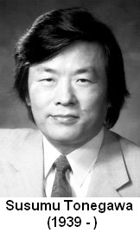
Mechanism of Ab diversity
Immunoglobulin genes rearrange, in 1976
(In 1987, Tonegawa was awarded the Nobel prize)

Slide 2
Lecture Outline
Generation of Ig Diversity and Germline Rearrangement
    Multiple gene segments
    Somatic DNA Recombination
    Generation of Junctional Diversity
Expression of the Rearranged Ig Heavy Chain Gene Locus
  Allelic Exclusion
  Alternative Splicing of μ/δ heavy chain RNA transcript
  Membrane-bound (BCR) vs. secreted (antibody) Ig
Somatic Hypermutation
Class Switching
Gene conversion

Slide 3
Problem…the immune system makes over one billion different antibody proteins
In 1950’s: central dogma stated DNA—to RNA—to protein
One gene for each protein (Ab)
Required millions of genes >10¹⁰ just for the antibodies
Does not seem possible, but most scientists thought it might be
Today we know the human genome is less than 30,000 genes
So, what is really going on???

Slide 4
Instructive theory:
Ag act as a template---The Ab change its tertiary structure to fit the Ag
From one Ab protein, huge number of specific Abs could be produced according to huge number of Ags (taloring).
Few Abs could solve the problem
Selection theory (tailored)
The Ag selects the best fit Ab among billions of different Abs.
Billions of Abs exist that require billions of genes.
What is really going on???? Tonegawa?

Slide 5
Gene expression
Exons (coding) and introns (noncoding) genes
Leader exon at 5’ end codes for 10 hydrophobic a.as (signal peptide).
Regulatory genes that bind transcription factors that initiate transcription.
Primary RNA transcription:
5’ cap and 3’ A tail
RNA splicing: removal of introns
Secondary RNA or Mature RNA transfer to cytoplasm

Slide 6
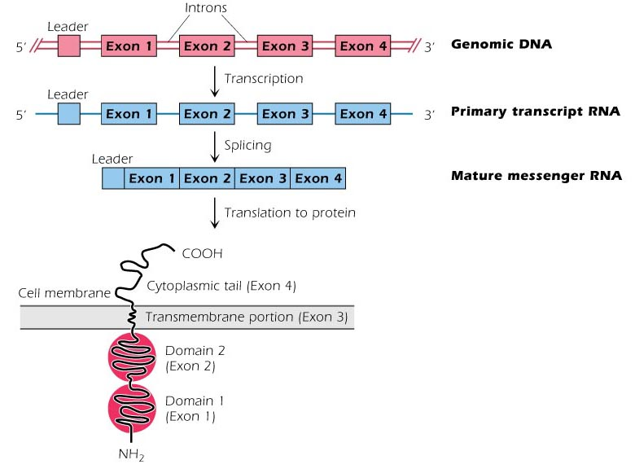
κ Chain synthesis

Slide 7
Every diploid cell contains the same genes as every other cell. The only exception are lymphocytes. They differ from other cells and from each other in the content of genes.
The expression of a specific pattern of genes determine the cell’s function. Every cell contains an insulin gene, but only pancreatic cells express that gene. All cells contain Ig genes, but only B lymphocytes express Ig genes and synthesize Abs.
T cells contain Ig genes but do not express them. Ig gene expression is inhibited in T cells because of silencer DNA binding proteins
Control of genes include the activity of transcription factors, the rate of transcription, and the half life of mRNA. Genes occupy only 1-2% of the total human genome

Slide 8
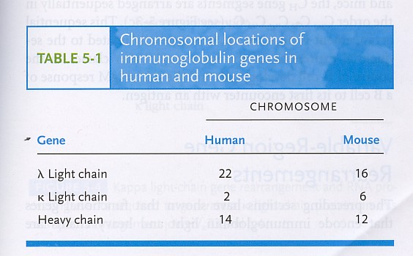
Genes for immunoglobulin proteins are found on different chromosomes

Slide 9
Seven means of Ab diversification
Before Ag exposure
① Multiple germ-line gene segments
(functional gene segments + many pseudogenes)
② combinational V-(D)-J joining
(due to the random rearrangement of these segments in somatic cells)
③ combinational association of light & heavy chains.
-> minimal calculations of potential Ab diversity : > 10⁶
④ Junctional flexibility
(the RSS joined the signal sequences precisely but not the coding
sequences leading to many nonproductive rearrangement)
⑤ P-region nucleotide addition, producing palindromic sequence in the
coding joint
N-region nucleotide addition, (up to 15 Nucleotides can be added by TdT)
After Ag exposure
⑥ Somatic hypermutation
⑦ Class switching

Slide 10
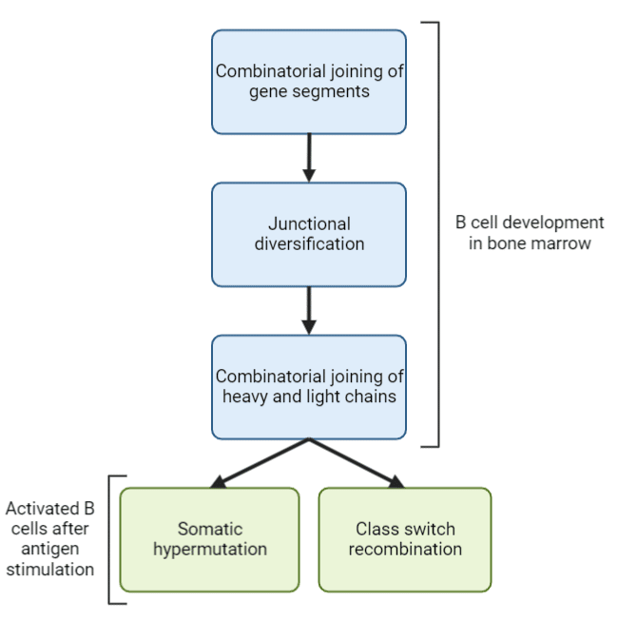

Slide 11

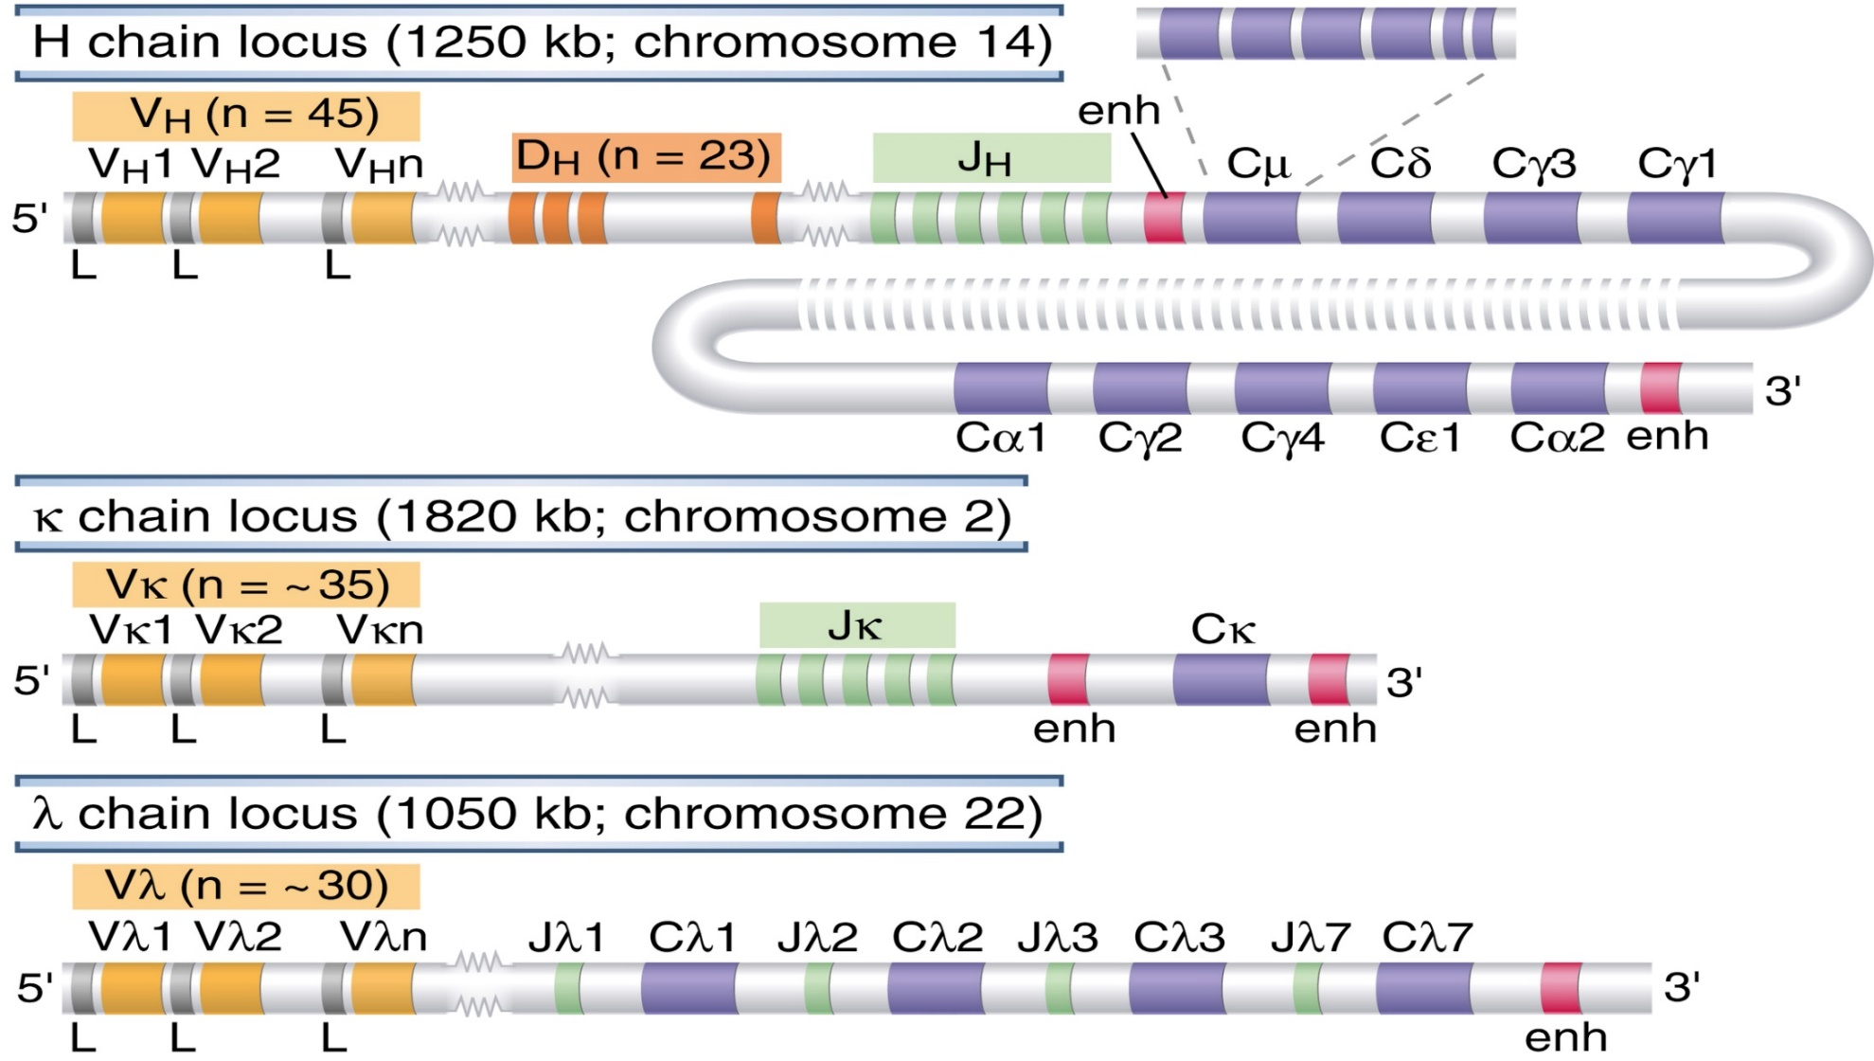

Slide 12
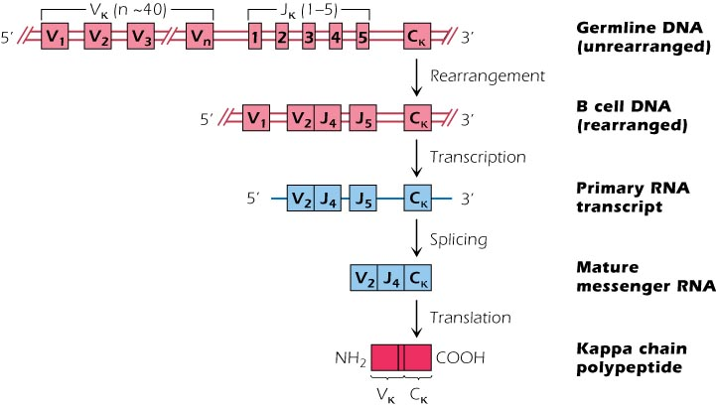
Light chain variable region diversity
2. DNA recombination

Slide 13
DNA rearrangement of Ig κL chain
2 different gene segments Vκ and Jκ codes for the V region of the L chain and a different C gene, codes for the constant region.
40 Vκ segments, separated by introns, 5 different Jκ segments downstream and a single C gene. The Vκ, Jκ and C regions are separated from each other by long stretch of DNA. Each Vκ has its own L sequence
The V and J gene segments are brought together to create the coding sequence for the variable domains of Ab chains. In an Ig light chain protein (κ or λ), the V domain is encoded by the rearranged V and J gene segments;
The joined Vκ Jκ gene segments with the Cκ gene , then synthesize a complete L chain.
The enzyme responsible for the DNA rearrangement in H and L genes is called V(D)J recombinase

Slide 14
Each Vκ gene segment has the ability to code for the N-terminal 95 a.a. of the Vk region. Each of the Jκ code for the remaining 13 a.a (96-108).
Early in the B.M (fetal stage), each B cell selects one of the Vκ genes and joins it to one of the Jκ segments. The process is random.
The rearrangement of Vκ to Jκ and all rearrangements including all Ig and TCR genes, mediated by VDJ recombinase enzyme complex.
2 of its components RAG-1 and RAG 2 are expressed exclusively in developing lymphocytes.
RAG1 &2 are required in cutting of Ig DNA so they are essential for the development of B and T cells.
Deficiency of RAG1 &2 cause SCID disease.

Slide 15
Lymphocyte-specific enzyme that mediate V(D)J recombination recognize DNA sequences called recombination signal sequences (RSSs) that are located 3′ of each V gene segment, 5′ of each J segment, and flanking each side of every D segment.
The RSSs consist of a conserved stretch of 7 nucleotides, called the heptamer, usually CACAGTG, located adjacent to the coding sequence, followed by a spacer of either 12 or 23 non-conserved nucleotides, followed by a conserved AT-rich stretch of 9 nucleotides, called the nonamer.
Specific residues in the heptamer and nonamer contribute to the binding of the recombinase enzyme that mediates joining. The 12- and 23-nucleotide spacers are brought close to one another for recombination

Slide 16
The recombinase joins together the Vκ 2 and Jκ 4 segments and the intervening sequences containing Vκ 3, Vκ 4 itc… is looped, cut out and ultimately degraded. This forms the primary RNA transcript.
The primary transcript is then spliced to give a mature RNA without introns and Vκ -Jκ 4-Cκ are brought together.
In RER: mRNA is translated into complete k polypeptide chain.
The polypeptide moves into the lumen of the ER where the signal peptide encoded by the leader is cleaved off.
The k chain can now associate with a newly synthesized H chain to form an Ig molecule.

Slide 17
V, D, J flanking sequences
Sequencing up and down stream of V, D and J elements
Conserved sequences of 7, 23, 9 and 12 nucleotides in an arrangement that depended upon the locus (Recombination signal sequence RSS)
Vλ
7
23
9
9
12
7
Jλ
Vκ
7
12
9
9
23
7
Jκ
9
12
7
D
7
12
9
V_{H}
7
23
9
9
23
7
J_{H}
12-23 RULE – A gene segment flanked by a 23mer RSS can only be linked to a segment flanked by a 12mer RSS

Slide 18
Why do V regions not join to J or C regions?
V_{H}
D_{H}
J_{H}
C
IF the elements of Ig did not assemble in the correct order, diversity of specificity would be severely compromised
2x
1x
DIVERSITY
DIVERSITY
Full potential of the H chain for diversity needs V-D-J-C joining - in the correct order
Were V-J joins allowed in the heavy chain, diversity would be reduced due to loss of the imprecise join between the V and D regions

Slide 19
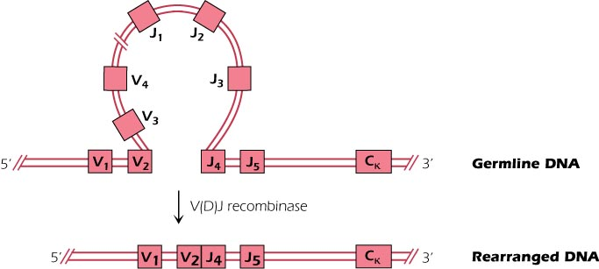
DNA recombination

Slide 20
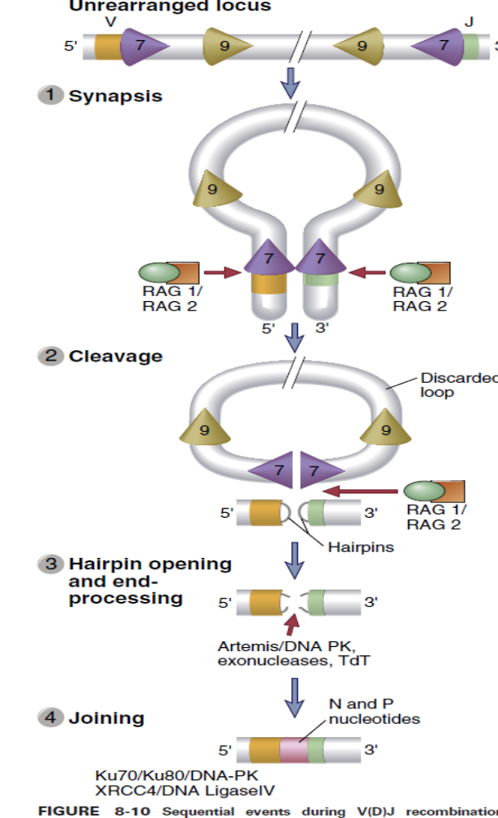

Slide 21
Synthesis of λ L chain
The locus is found on chromosome 22 different from κ and H chain
The mechanism is similar to that of κ chain
30 Vλ and 4Jλ Mediated by VDJ recombinase
Each Jλ is associated with different Cλ but have similar function

Slide 22
Heavy chain
Found on human chromosome 14
3 different gene segments codes for the V region: 40 VH, 25 DH, 6JH. in the Ig heavy chain protein, the V domain is encoded by the recombined V, D, and J gene segments
Human have 9 H genes: codes for Ig classes and subclasses.
Cμ is closest to the J segments
Use the same mechanism as the L chain
First stage of differentiation D join J then the V attach forming immature B cell with only surface IgM
Second stage is mature B cell with IgM and IgD (Alternative splicing)
IgM, IgA, IgG and IgE (but not IgD) can exist in a secreted form by plasma cells (alternative splicing).

Slide 23
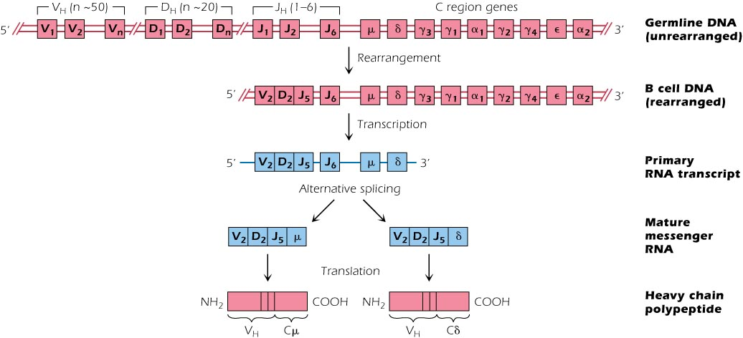
Heavy chain Variable diversity

Slide 24
3. Junctional diversity
Noncoding or none template N- nucleotides (nt): Up to 15 or so randomly inserted nt bases are added at the cut sites of the V, D and J regions (Ends).
This mediated by TdT (terminal deoxynucleotidyl transferase) a unique enzyme found only in lymphocytes.
TdT is the only known polymerase that catalyze the synthesis of 2-15 nt DNA polymers from free nts in solution in vivo.
Pallindromic or p nts: During recombination some nt bases are cut from or add to the coding regions by a mechanism that do not involve TdT.
A palindromic sequence of nts (which are labeled A, T, C, or G) occurs when complementary strands of DNA read the same in both directions, either from the 5-prime end or the 3-prime end.
The overall result of the addition or deletion of nts is to make the junctions between V, D, J segments highly variable creating diversity in the Fab region

Slide 25
Junctional Diversity – N nucleotide additions
N region addition is the addition of non-coded nts during recombination by TdT.
TDT adds nts randomly to the exposed nt ends of the ss V and D segment DNA. Unlike most DNA polymerases, it does not require a template.
V
TC~GA
AG
CACTCCTTA
D
J
AT
TA~TA
TTCTTGCAA
V
TC~GA
AG
CACACCTTA
D
J
AT
TA~TA
Complementary bases anneal
TTCTTGCAA
V
TC~GA
CACACCTTA
D
J
TA~TA
Exonucleases nibble back free ends
TTCTTGCAA
TC
V
D
DNA polymerases fill in the gaps and DNA ligase IV joins the strands
TC~GA
AG
CACACCTTA
J
V
GTT AT AT
D
AT
TA~TA
TA
TTCTTGCAA
AG C
Tdt modify the length and coding sequence Junctional flexibility in the joining of Ig gene segments. Responsible for 95% of Junctional diversity.

Slide 26
Generation of the palindromic sequence
P nt insertion is the insertion of palindromic sequences encoded by the ends of the recombining gene segments.
U
D
J
TC
AG
U
AT
TA
V
Regions to be joined are juxtaposed
U
Endonuclease cleaves single strand at random sites in V and D segment
D
J
TC
AG
U
AT
TA
V
The nicked strand ‘flips’ out
The nts that flip out, become part of the complementary DNA strand
V
TC~GA
AG
AT AT
D
J
AT
TA~TA
AG CT
The sequence in one strand is the same as the complementary sequence of the other strand when read from the same direction on both the strands, either 5' to 3' or 3' to 5‘.
Introduce diversity of sequence at the V to D join. Responsible for 5% of junctional diversity

Slide 27
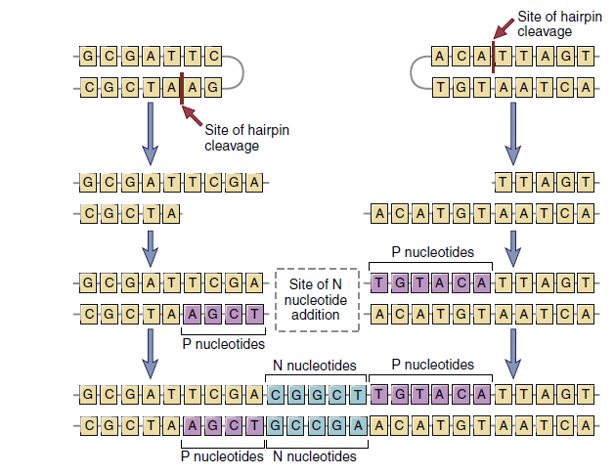

Slide 28
4. Reading D segment in 3 frames
Since DNA is interpreted in codons, DNA strand has three distinct reading frames. The double helix of a DNA molecule has two anti-parallel strands; with the two strands having three reading frames each, there are six possible frame translations.
There are three possible reading frames in any sequence, depending on the starting point. If the first frame starts at position 1, the second frame starts at position 2, and the third frame starts at position 3.
GGGACAGGGGGC
GlyThrGlyGly
GGGACAGGGGGC
GlyGlnGly
GGGACAGGGGGC
AspArgGly
Frame 1
Frame 2
Frame 3

Slide 29
5. Allelic exclusion
Every B cell has 2 sets of chromosomes: one set from each parent.
Allelic exclusion is : Using genes from only one parental chromosomes. The cell first tries rearrangement at one of the 2 κ loci. In case of productive functional rearrangement, rearrangement does not occur at the other κ locus (silenced). If the rearrangement is nonproductive, rearrangement at the other locus occurs.
Allelic exclusion: successful rearrangement of 1 allele excludes rearrangement of the other allele. As a result, one B cell synthesizes an Ig molecule of only a single antigenic specificity.

Slide 30
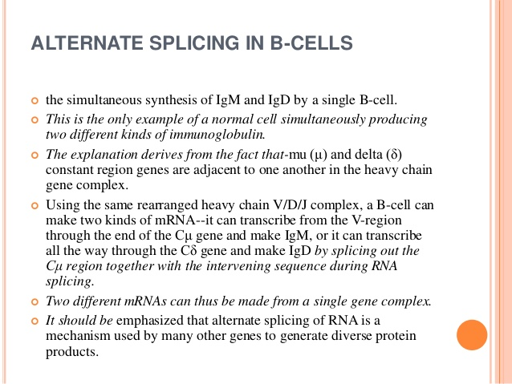
6.

Slide 31
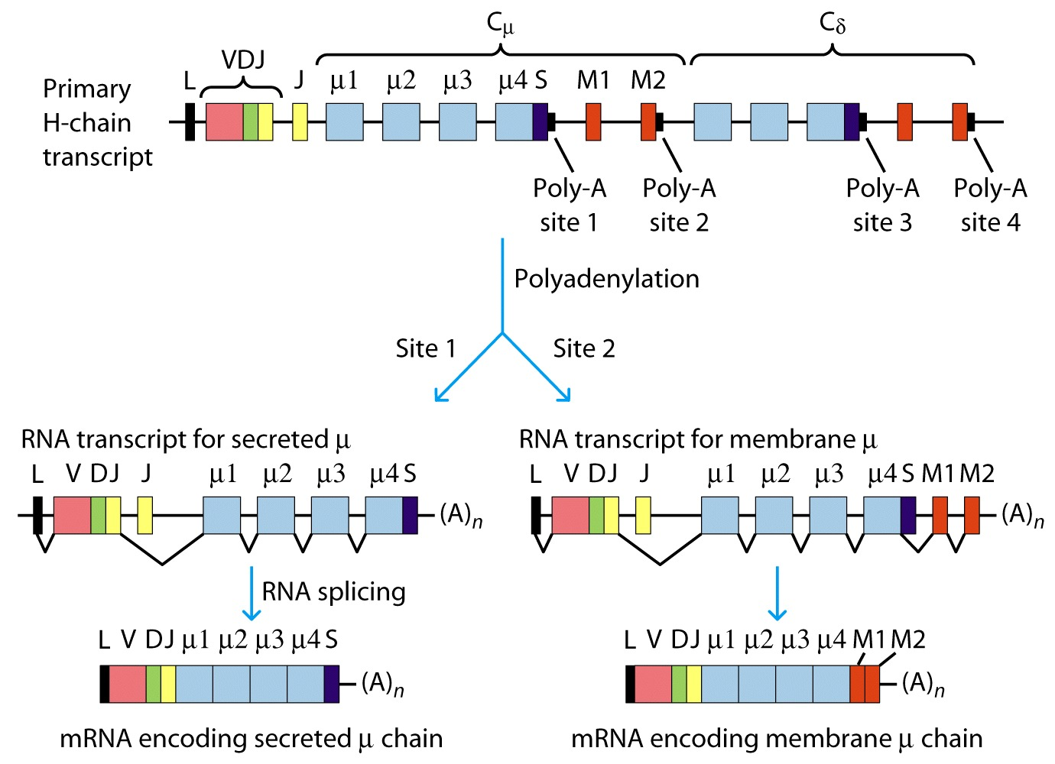
(b)
cleavage
In differentiated plasma cells
In naïve mature cells
Expression of secreted and membrane forms of the heavy chain by alternative RNA processing.

Slide 32
7. Somatic hypermutation (After Ag exposure)
SHM generates diversity throughout the V region and that operates on B cells in peripheral lymphoid organs after functional Ig genes have been assembled.
Exp. evidence for somatic mutation in variable regions CDR of Ig genes H and L during the lifetime of a B cell. Random Point mutation in the VDJ unit
SHM is restricted to somatic cells and germ cells are unaffected
Where SHM occurs: In Germinal centers of B follicles in lymph nodes
The mechanism: The key enzyme is Activation-induced cytidine deaminase. Occurs at rate of 10⁶ times higher the normal rate of mutation. Why? Due to mutational hot spots targeted by the mutational apparatus
Two types of B cells are produces: High affinity and low affinity. Low affinity B cells die and the high survive. The mutant Ig molecules bind Ag better than the original BCR, and B cells expressing them are preferentially selected to mature into Ab-secreting cells. This gives rise to a phenomenon called affinity maturation of the Ab population

Slide 33
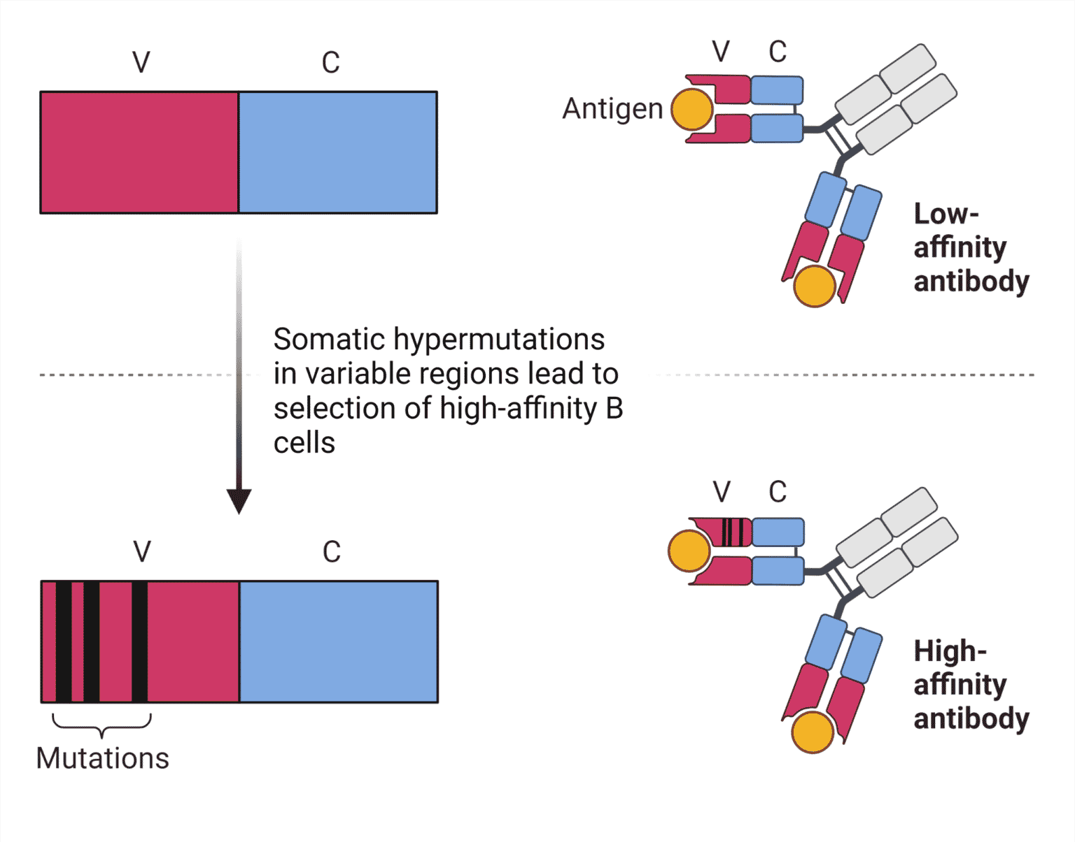
During the tertiary immune response, the affinity of antibodies increases even 100–1000 fold.

Slide 34
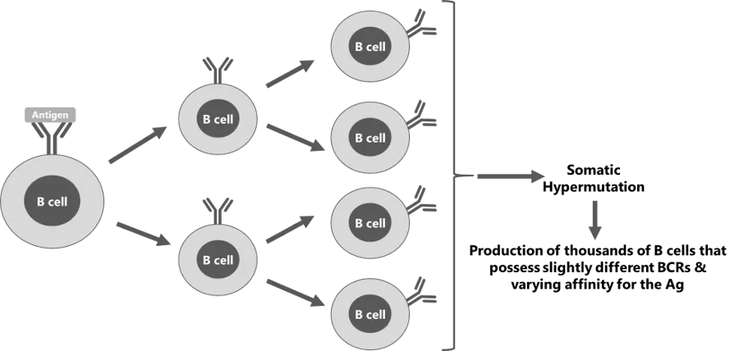

Slide 35
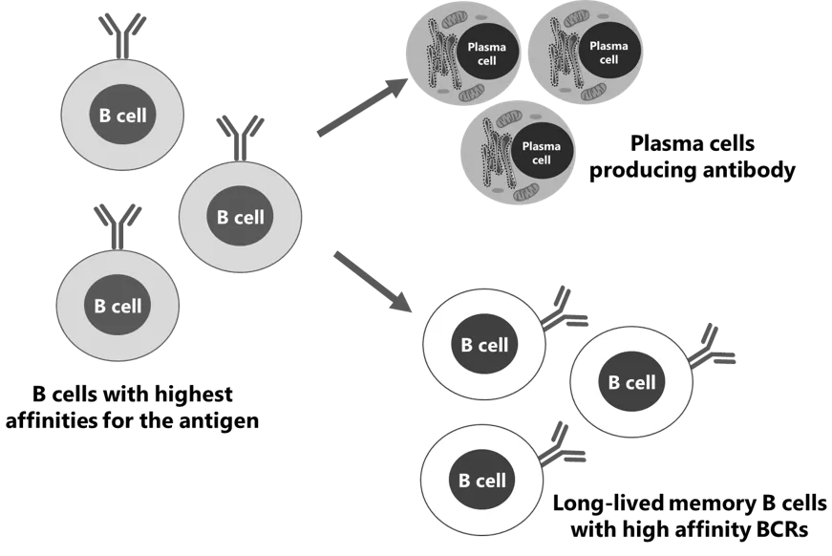

Slide 36
Somatic hypermutation
FR1
CDR1
FR2
CDR2
FR3
CDR3
FR4
100
Variability
80
60
40
20
20
40
60
80
100
120
Amino acid No.
Primary i.r has low affinity but in secondary i.r has high B cells with higher affinity receptors will be preferentially selected for survival : affinity maturation Increase both the variety and the affinity of Abs.
Unlike germline mutation, affects only individual immune B cells, and the mutations are not transmitted to offspring

Slide 37
8. Class switching
Unique to Ig heavy-chain genes: it allows an Ab to associate with different constant regions and thus have different effector functions.
Changes the effector function of the B cell but does not change the cells antigenic specificity
Five elements : switch regions s + switch recombinase + cytokine signals + Activation-induced cytidine deaminase (AID) + Ag
a. S a stretch of repeating base sequences at 5’ end of every CH gene except Cδ. S permit any of the CH genes (except Vδ) to associate with the VDJ. The intervening C region DNA is removed. The remaining introns are spliced out . In the Fig, this B cell synthesizes an IgG1 only.

Slide 38
Switching involves the deletion of intervening DNA between specific recombination sites called switch regions. Because the intervening DNA is lost, the B cell cannot ‘switch back’ to an isotype that has already been deleted.
b. Recombinase: a B cell linked to Cu and Cδ further rearrange its DNA to link the VDJ to an S region in front of another CH gene (γ1 for IgG1).
c. T cell derived cytokines: IFNγ−IgG3, IL-4−IgE, itc….
d. AID: is expressed by B cells activated in the germinal centers of secondary lymphoid organs
e. Ag stimulation: activated mature B cell IgM+IgD+ undergoes class switching

Slide 39
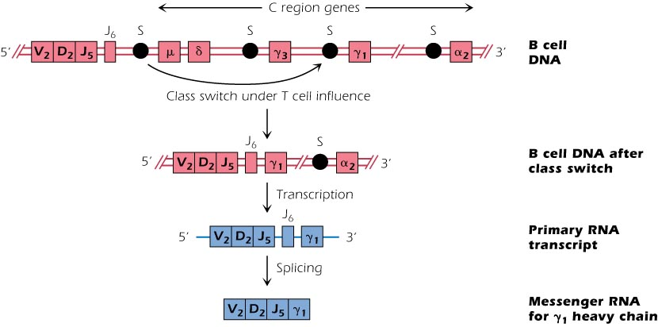

Slide 40
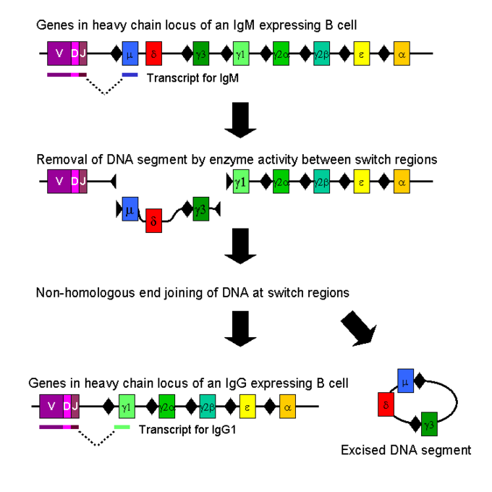
Non-homologous end joining (NHEJ) is a pathway that repairs ds breaks in DNA. NHEJ is "non-homologous" because the break ends are directly ligated without the need for a homologous template.

Slide 41
Table 2. Class switching in human
T cells | Cytokines | Immunoglobulin classes
 |  | IgG1 | IgG2 | IgG3 | IgG4 | IgA | IgE
Th2 | IL-4 |  |  |  | ↑ |  | ↑
 | IL-5 |  |  |  |  | ↑
Th1 | IFNγ | ↑
Treg | TGFβ |  |  |  |  | ↑

Slide 42
Regulation of Ig expression
After VDJ joining, the promoter 5’ to the V region is brought within a few thousand base
Pairs of the enhancer element between the J region and the constant region.
The enhancer greatly increases the rate of transcription, increasing Ig production.
Ig production is further increased in the differentiation of B cells into plasma cells.

Slide 43
Gene conversion
Nonreciprocal (unidirectional) exchange of sequences among genes. Part of the donor gene is copied into an acceptor gene. But only the acceptor gene is altered.
In mammals other than human and mouse, there not be a lot of variable gene segments for diversity. They rely on gene conversion and somatic hypermutation before Ag stimulation.
chicken used gene conversion as a major mechanism while sheep use somatic hypermutation
Instead they have pseudogenes (defective)
B cell cytidine deaminase insert a U that is removed , leaving a gap in the nearest V gene. The gap is filled by randomly selected short segments obtained from pseudogenes.

Slide 44
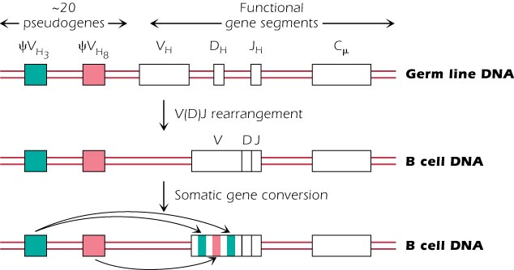
Gene conversion
Birds and rabbits
Activation-induced cytidine deaminase play a role

